Slide 1
Fall 2023
Spring Performance Review
SEMESTER PERFORMANCE
(08/31/23-11/30/23)
SMIF PORTFOLIO: 1.15%
BENCHMARK: .79%
Active Return 0.36%
AUM $2,011,366.96
Notes:
Joseph

Slide 2
Agenda
Performance
Portfolio Characteristics
Rebalancing Reflection
Summary of Semester Changes
Sector by Sector Update
Q&A
Notes:
Joseph

Slide 3
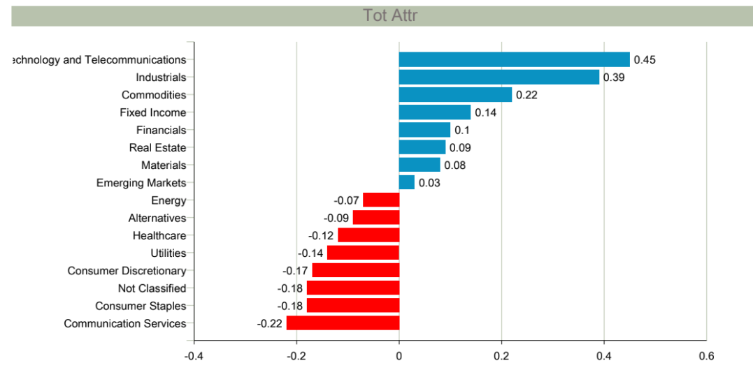
PERFORMANCE
(AS OF 11/30/2023)
Semester Performance
(8/31/23-11/30/23)
SMIF Portfolio | 1.15%
Benchmark | 0.79%
Value | .36%
Commentary
First time over $2 million AUM since 12/21
Out performance of 36 bps and peaking outperformance during the semester of 133 bps
Strong performance driven by Tech, Industrials, and Commodities
Consumer Staples and Com Services lagged
Te
Notes:
Joseph

Slide 4
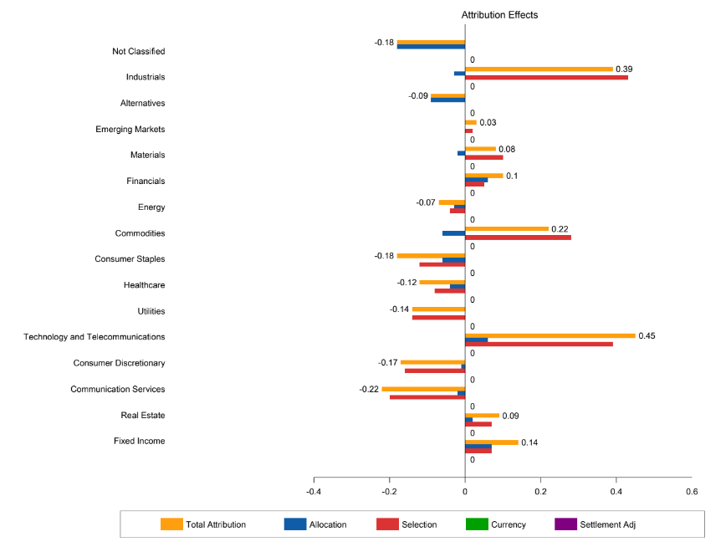
PORTFOLIO CHARACTERISTICS (AS OF 11/30/2023)
Ratios
 | Sharpe | Beta | Jensen Alpha | Information Ratio | Standard Deviation (Annualized)
SMIF Portfolio | 0.69 | 0.90 | 2.25 | 0.60 | 8.30
Benchmark | 0.45 | NA | NA | NA | 8.73
*3 Months |  |  | (Return above CAPM) | (Return above Bench)
Attribution
(8/31/23-11/30/23)
Allocation | -0.33%
Selection | 0.66%
Sum of Factors | 0.33%
Commentary
Strong selection effect in industrials due to overweight defense
Strong selection effect in tech due to timely purchases, CRWD, and MSFT
Overweight precious metals contributing significantly
Notes:
Joseph

Slide 5
PORTFOLIO CHARACTERISTICS (AS OF 11/30/2023)
Top 5 Equity Holdings | % of Assets
Microsoft Corp | 3.15%
Waste Management | 1.93%
Crowdstrike | 1.77%
Applied Materials | 1.76%
Cigna | 1.73%
Top 5 FI/FX & Alternatives Holdings | % of Assets
SPDR Gold Trust | 3.74%
iShares MBS ETF | 3.02%
Vanguard Total Bond Market Index Fund | 3.01%
iShares 7-10 Year Treasury Bond ETF | 2.93%
PIMCO 1-5 Year US TIPS | 2.91%
Dual Investment Mandate
Preservation of Capital
Long-term Capital Appreciation
Investment Objectives
Target an annual return equal or greater than the University Endowment Fund spending rate plus 1% over inflation
Outperform the fund’s benchmark on a monthly and yearly basis
Historical Performance
 | Semester | YTD | 5-Year* | 10-Year* | Since Inception*
SMIF Portfolio | 1.15% | 4.96% | 4.4% | 5.1% | 5.2%
Benchmark | 0.79% | 9.96% | 5.5% | 5.2% | 5.5%
 |  |  |  |  | *From 02/2010
 |  |  | *Updated Bloomberg does not have past 1YR | **Benchmarks for Fixed Income and Commodities were non-materially adjusted in 2015 and 2019, respectively.
Benchmark Composition
Equities: S&P 1200 Global | 50%
Fixed Income: Vanguard Total Bond Market Index | 40%
Commodities: Invesco DB Commodity Index | 6%
Real Estate: SPDR DJ Global Real Estate ETF | 4%
Notes:
Rishika

Slide 6
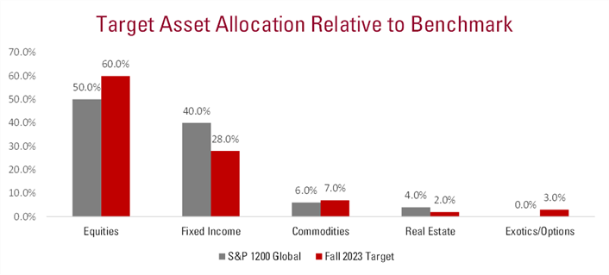
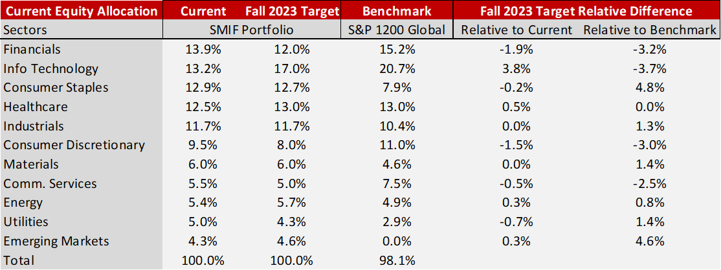
Rebalancing Reflection
Rebalancing Allocation Highlights
Short duration strategy
Defensive equity allocation
Black Swan hedge
Exotics revamp
Decreased Real Estate 200 bps
Increased Allocation Tech 380 bps
Decreased Financials 190 bps
*Benchmark allocates 2.1% to Real Estate (RE); SMIF reports RE holdings under Alternatives **SMIF allocates 4.1% to Emerging Markets (EM); Benchmark has no EM classification
Notes:
Afwan

Slide 7
Beginning of Semester Goals
Risk Management
Improved Pitches
Exotics Revamp
Alumni Event
Outperform Benchmark
Notes:
Afwan

Slide 8
Rates & Spread Products
INVESTMENT OUTLOOK / FACTORS
RISK FACTORS
Rates Products
US Federal Reserve approaches end of rate hike cycle
Weakening economic fundamentals + better than expected CPI print => higher conviction on a potential Fed pivot
Asymmetry in longer duration assets
Given peak rates and positive convexity, there is significant asymmetry in longer duration assets to take advantage of
Spread Products
We maintain our thesis on bifurcation between high quality credit versus low quality despite outperformance by leveraged loans this semester
We also believe there are relative value plays in the market, such as agency MBS that provide attractive spread over duration
Rates Products
Inflation reacceleration
2024 US presidential election delaying Fed rate cycle
Supply-side shocks
Spread Products
Large supply of issuances
Falling corporate profits
Richard Fu & Afwan Kibria

Slide 9
Rates & Spreads
Semester Actions
OPPORTUNITIES
Performance Attribution
9/14: Rates
Sold UDN, FXY, & FXB
Bought UUP
9/14: Spreads
Bought MBB
11/9: Rates
Sold STIP, TLT, & UUP
Bought IEF, IEI, & SHY
11/9: Spreads
Sold SRLN
Bought VCIT
September - November
Stronger than expected US growth
Higher rates for longer
Persistent 3% inflation
Yield dislocation in MBS products
November - Present
Potential Fed pivot
Asymmetry in longer duration assets
Tighter spreads in quality assets
FI Benchmark Return: 0.40%
Fall 2023 Return: 0.76%
Allocation Effect: 0.07
Selection Effect: 0.07
Total Attribution: 0.14
Richard Fu & Afwan Kibria

Slide 10
Rates + Spreads
CURRENT HOLDINGS
**Price Nov 30th

Slide 11
Real Estate
INVESTMENT OUTLOOK / FACTORS
RISK FACTORS
Stabilizing Interest Rates, Declining Mortgage Rates
Fed expected to begin cutting rates in ‘24 creating opportunities for RE
Avg 30 year mortgage rates reaching 4 month lows
Long term secular macro tailwinds
Continued long term secular demand for logistics facilities, data centers, retail, and cell towers which are partially immune to broader market conditions and allow for substantial room for growth within our portfolio
High-Risk Office Sector
Higher For Longer Rates
Class B and C Properties
CURRENT HOLDINGS
**Price Dec 11
Mitchell Hyneman

Slide 12
Real Estate
Semester Actions
OPPORTUNITIES
Performance Attribution
9/26 - Held AMT
9/26 - Held PLD
Declining Mortgage Rates
Lower Financing Costs
High Logistics/Data Center Demand
Fall 2023 Return: 2.83%
Allocation Effect: 0.02
Selection Effect: 0.07
Total Attribution: 0.09
Mitchell Hyneman

Slide 13
Commodities
INVESTMENT OUTLOOK / FACTORS
RISK FACTORS
El Nino
The cyclical weather pattern has caused cocoa shortages on the Ivory coast and Ghana causing future contracts to skyrocket
Gold Rush
Heightened geopolitical tension, easing rates, and a weaker dollar is causing a massive rally with no plan of stopping
Platinum?
- Despite consensus out of shortages Platinum continues to underperform
- We continue to believe in this position and in a price correction in the future
INVESTMENT OUTLOOK / FACTORS
INVESTMENT OUTLOOK / FACTORS
Unexpected Rate Hikes
Strong Dollar
China Economic Collapse
Higher Agriculture Supply
CURRENT HOLDINGS
Commodities | Ticker | % of Sector | % of Assets | Quantity | Current Price | Market Value | Return (Semester)
Invesco DB Agriculture Fund | DBA | 21.82% | 1.47% | 1385 | $22.02 | $30,497.70 | 0.73%
SPDR Gold Trust | GLD | 41.20% | 2.78% | 300 | $192.01 | $57,603.00 | 5.23%
abrdn Physical Platinum Shares ETF | PPLT | 11.10% | 0.75% | 180 | $86.23 | $15,521.40 | -3.97%
Invesco DB Commodity Index Tracking Fund | DBC | 25.88% | 1.75% | 1520 | $23.80 | $36,176.00 | -1.27%
 | Totals |  | 6.75% |  |  | $139,798.10
Joseph Andrews

Slide 14
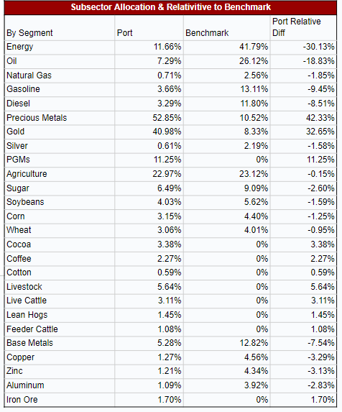
Commodities
Allocation
Performance Attribution
Overweight precious metals
Overweight agriculture Cocoa & Livestock
Underweight base metals due to weak China & demand
Fall 2023 Return: 1.15%
Allocation Effect: -0.06
Selection Effect: 0.22
Total Attribution: 0.16
OPPORTUNITIES
Flight to Quality
Weak Dollar
Lower Rate Expectations
Stable Agriculture Demand
Weaker Agriculture Supply
Correlation to Benchmark
Correlation
0.30
Joseph Andrews

Slide 15
Basic Materials
INVESTMENT OUTLOOK / FACTORS
RISK FACTORS
Destocking to Restocking
Demand is expected to pick up in ‘24 leading to a modest rebound
Weakening inflation will cause restocking to rise once again
Energy Transition drives Chemicals Demand
As the energy landscape continues to transition into renewable energy, chemical companies have a unique opportunity to see demand rise
Raw Material Prices
Supply Chain Constraints
Under Expected Demand
Cyclicality (Demand/Pricing)
CURRENT HOLDINGS
Basic Materials | Ticker | % of Sector | % of Assets | Quantity | Current Price | Market Value | Return (Semester)
Air Products and Chemicals Inc | APD | 20.96% | 0.57% | 43 | $272.64 | $11,723.52 | -8.41%
International Paper Co | IP | 33.90% | 0.92% | 510 | $37.19 | $18,966.90 | -0.95%
Materials Select Sector SPDR Fund | XLB | 45.14% | 1.22% | 303 | $83.35 | $25,255.05 | -1.72%
 | Totals |  | 2.70% |  |  | $55,945.47
**Price Nov 30
Joseph Andrews

Slide 16
Basic Materials
Semester Actions
OPPORTUNITIES
Performance Attribution
NA
Renewable Energy Positioning
Weakening Inflation
Cyclicality (Supply chain)
Fall 2023 Return: 1.15%
Allocation Effect:-0.02
Selection Effect: 0.08
Total Attribution: 0.06
Segment | Benchmark % | % from Stocks | % from Benchmark | Total | Net Factor Exposure
Chemicals | 67.83% | 22.28% | 31.03% | 53.31% | -14.52%
Metals & Mining | 16.50% | 0.00% | 7.55% | 7.55% | -8.95%
Containers & Packaging | 9.49% | 31.97% | 4.34% | 36.31% | 26.82%
Construction Materials | 6.18% | 0.00% | 2.83% | 2.83% | -3.35%
Joseph Andrews

Slide 17
Emerging Markets
INVESTMENT OUTLOOK / FACTORS
RISK FACTORS
Return to Growth
Following a sharp decline throughout 2021 and 2022, earnings growth expectations over the next twelve months has moved higher for emerging markets compared to developed markets, including the United States
Dealing with Inflation
Emerging Markets and their central banks will have to continue to contend with higher rates of inflation, of which many projections still put within the upper-range of forecasts
Peak in the U.S. Dollar Strength
The potential for rate cuts and a peak in dollar strength will greatly benefit emerging markets currency and debt.
● Inflation
● Geopolitical Risk
● Slowing Demand
● EM Debt
CURRENT HOLDINGS
Nick Siracuse

Slide 18
Emerging Markets
Semester Actions
OPPORTUNITIES
Performance Attribution
9/29 - Bought EIDO
9/29 - Trimmed VWO
11/13 - Sold ECH
11/13 - Bought EWX
● Peak in U.S. Dollar Strength
● Earnings Growth in Asia
● Shifting Trade Relationships
Fall 2023 Return
% Return Month: 5.17%
% Return Semester: 4.23%
% Return YTD: 3.31%
Segment | % of Sector | % of Assets | Quantity | Market Value
Brazil | 10.45% | 0.31% | 185 | $6,241.90
Indonesia | 15.63% | 0.46% | 438 | $9,338.16
South Korea | 11.56% | 0.34% | 110 | $6,905.80
India | 25.24% | 0.75% | 314 | $15,075.14
Nick Siracuse

Slide 19
Consumer Staples
INVESTMENT OUTLOOK / FACTORS
RISK FACTORS
Strength in Consumer Spending Increased Despite Inflation
Strong consumer spending trends persist in leisure
Alcohol consumption channels near pre-COVID levels
Pricing Power is Starting to Fall
Tough to raise prices due to disinflationary environment
Companies have experienced moderate volume declines and trade downs
Alignment to our Benchmark
Revising allocation to be in closer alignment with KXI
Short Position in Diversified Retail and Packaged Foods
GLP-1 Drugs
Foreign Exchange Risk
CURRENT HOLDINGS
Consumer Staples | Ticker | % of Sector | % of Assets | Quantity | Current Price | Market Value | Sem Return
Coca-Cola Co | KO | 12.41% | 0.58% | 200 | $59.00 | $11,800.00 | -2.09%
Sprouts Farmers Market | SFM | 17.10% | 0.81% | 350 | $46.46 | $16,261.00 | 0%
Unilever plc | UL | 22.41% | 1.05% | 450 | $47.34 | $21,303.00 | -6.12%
Diageo PLC | DEO | 8.24% | 0.39% | 55 | $142.35 | $7,829.25 | -15.06%
iShares Global Consumer Staples ETF | KXI | 39.84% | 1.88% | 645 | $58.72 | $37,874.40 | -2.16%
Rishika Pal

Slide 20
Consumer Staples
Semester Actions
OPPORTUNITIES
Performance Attribution
9/6 - Trim DEO and KO
11/30 - Buy SFM
11/30 - Sell BG
11/30 - Trim KO
11/30 - Buy KXI
Fall 2023 Return: 4.40%
Allocation Effect: 0.06
Selection Effect: 0.12
Total Attribution: 0.18
Cost structure improvements
Trade Down to Snacks
Emerging Ready-to-Drink brands
Segments - Staples | Benchmark % | SMIF Individual | From Benchmark | Total | Net Factor Exposure
Staples Retail | 24.76% | 17.12% | 9.86% | 26.99% | 2.23%
Household & Personal | 24.61% | 22.41% | 9.80% | 32.21% | 7.60%
Packaged Foods | 19.47% | 0.00% | 7.75% | 7.75% | -11.72%
Tobacco | 8.74% | 0.00% | 3.48% | 3.48% | -5.26%
Farm Products | 1.92% | 0.00% | 0.76% | 0.76% | -1.16%
Beverages | 20.09% | 20.64% | 8.00% | 28.64% | 8.55%
Rishika Pal

Slide 21
Consumer Discretionary
INVESTMENT OUTLOOK / FACTORS
RISK FACTORS
Wealth and Generational Shift
Ultra-wealthy consumer spending habits are unaffected by adverse economic conditions, persisting steady demand
Fashion casualization emphasizing comfort over elegance
Foreign Conflicts
A property crisis, youth unemployment, and an aging population are preventing Chinese consumers from reverting to pre-pandemic spending
An increase in debt-to-GDP ratios in some European countries is attributable to sluggish economic growth and elevated interest rates.
● Overspending
● Housing and non-housing debt
● Shrink in retailers
● Weak Chinese consumer
**Price Nov 30
CURRENT HOLDINGS
John Sprufero

Slide 22
Consumer Discretionary
Semester Actions
OPPORTUNITIES
Performance Attribution
China Consumer Revival
Falling rates
Low cyclicality companies within a cyclical sector
10/23 - Bought ETD
10/23 - Sold LVMH
10/23 - Trimmed XLY
12/04 - Bought ZGN
12/04 - Trimmed ORLY
12/04 - Trimmed XLY
Fall 2023 Return: -3.81%
Allocation Effect: -0.01%
Selection Effect: -0.16%
Total Attribution: -0.17%
John Sprufero

Slide 23
Financials
INVESTMENT OUTLOOK / FACTORS
RISK FACTORS
Slower organic growth for banks
Capital is scarce in this economy due to a reserved consumer
Companies need to be creative in their pursuance of capital
Integrating new technologies into financial services
Firms will start to capitalize on generative AI, embedded finance, and the digitization of money
Continued monitoring of economic climate around inflation and interest rates
Inflation has started to fall and there has been a recent pause on rate hikes
Remains in the 5.25%-5.50% range and inflation has lowered to around 3%
Increased fraud / cyber attacks
High interest rates
Increased banking regulations
CURRENT HOLDINGS
Financials | Ticker | % of Sector | % of Assets | Quantity | Current Price | Market Value | Return (Semester)
Berkshire Hathaway Inc Class B | BRK.B | 13.64% | 1.13% | 63 | $360.02 | $22,681.26 | -0.06%
Citigroup Inc | C | 19.51% | 1.61% | 675 | $48.06 | $32,440.50 | 13.05%
Charles Schwab Corporation Common Stock | SCHW | 12.04% | 0.99% | 310 | $64.57 | $20,016.70 | 4.15%
American Express Company | AXP | 16.46% | 1.36% | 160 | $171.04 | $27,366.40 | 8.53%
Sun Life Financial Inc | SLF | 3.88% | 0.32% | 125 | $51.57 | $6,446.25 | 4.70%
Financial Select Sector SPDR Fund | XLF | 34.46% | 2.85% | 1565 | $36.61 | $57,294.65 | 4.89%
 | Totals |  | 8.26% |  |  | $166,245.76 | 5.37%
**Price Nov 30
John Koutsonikolis

Slide 24
Financials
Semester Actions
OPPORTUNITIES
Performance Attribution
11/9 - Sold USB
Diversification into more insurance and PE
E-commerce and digitalization
Fall 2023 Return: 5.37%
Allocation Effect: 0.06
Selection Effect: 0.05
Total Attribution: 0.10
Segment | Benchmark % | % from Stocks | % from Benchmark | Total | Net Factor Exposure
Financial Services | 33.35% | 14.38% | 11.55% | 25.93% | -7.42%
Banks | 23.86% | 19.39% | 8.26% | 27.65% | 3.79%
Capital Markets | 22.13% | 11.10% | 7.66% | 18.76% | -3.37%
Insurance | 17.16% | 4.00% | 5.94% | 9.94% | -7.22%
Consumer Finance | 3.50% | 16.50% | 1.21% | 17.71% | 14.21%
John Koutsonikolis

Slide 25
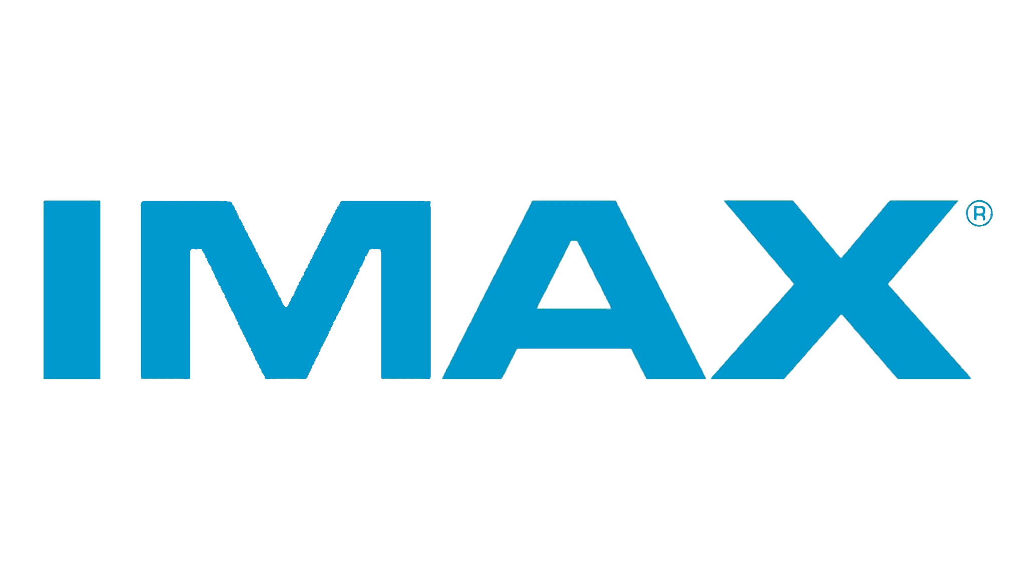
Communication Services
INVESTMENT OUTLOOK / FACTORS
RISK FACTORS
Media bundling and consolidation
Intense competition amongst the 80+ players within the streaming space will give way to more consolidation
Moderate ad-growth recovery
Mid-single digit growth expected by the industry
Low anticipated deal volume
Interest rate environment and an uptick in regulatory activity
● Cyber Security
● Highly Competitive Market
● Prone to Volatility
CURRENT HOLDINGS
Financials | Ticker | % of Sector | % of Assets | Quantity | Current Price | Market Value | Return (Semester)
Alphabet Inc Class A | GOOGL | 28.98% | 0.85% | 136 | $136.93 | $18,622.48 | -2.67%
Verizon Communications Inc. | VZ | 26.10% | 0.76% | 411 | $37.45 | $15,391.95 | 2.94%
Imax Corp | IMAX | 11.62% | 0.34% | 430 | $16.46 | $7,075.65 | -6.21%
iShares Global Comm Services ETF | IXP | 33.30% | 0.97% | 280 | $72.52 | $20,305.60 | 2.31%
 | Totals |  | 2.92% |  |  | $61,395.68 | -3.63%
Anoosha Barua
Notes:
Google: anti-trust. Slow growth in ad sector but we are expecting growth in other
Verizon: 5G is expected to be fully rolled out by 2025.
Imax: imax has dropped recently due to headwinds in the entertainment industry from the actors’ and writers’ strike in hollywood. Despite this, the company has made an 85% recovery to pre-pandemic levels and is expected to realize the rest of this in 2024. Additionally, since imax operates in the technology space of the entertainment industry, they’re more insulated than competitors like AMC.

Slide 26
Communication Services
Semester Actions
OPPORTUNITIES
Performance Attribution
11/08 - Bought IMAX
11/08 - Sold WBD
11/15 - Trim GOOGL
● Artificial Intelligence
● 5G Expansion
● Gaming
Fall 2023 Return: -3.63%
Allocation Effect: -0.02
Selection Effect: -0.12
Total Attribution: -0.22
Segment | Benchmark % | % from Stocks | % from Benchmark | Total | Net Factor Exposure
Interactive Media Services and Home | 54.03% | 30.28% | 18.01% | 48.28% | -5.75%
Integrated+Wireless Telecom | 26.10% | 25.06% | 8.70% | 33.76% | 7.66%
Movies & Entertainment | 11.24% | 11.33% | 3.75% | 15.08% | 3.84%
Cable & Satellite | 5.23% | 0.00% | 1.74% | 1.74% | -3.49%
Advertising, Broadcasting, and Publishing | 3.15% | 0.00% | 1.05% | 1.05% | -2.10%
Anoosha Barua
Notes:
ML and Generative AI are being increasingly used in the creative process to enhance advertising, assist in post-production, and speed up the content delivery process.
Currently, 5G is expected to be the leading smartphone connection type come 2025, and Verizon is the leader in this space in terms of quality offerings and infrastructure across the US.
Finally, US in-app games advertising has been the largest generator of social and casual revenue for this year, so we see this as a great opportunity to potentially get into next semester.

Slide 27
Energy
INVESTMENT OUTLOOK / FACTORS
RISK FACTORS
High Demand vs. Low Supply
Demand is expected to remain strong as economy rebounces
OPEC+ & Russia’s oil cut will put upward pressure on oil price
International Diversification & Growth Opportunities
Major stake in Guyana, 11 Billion Barrels
Strong balance sheet suitable for long term investors
Decline in Falling Oil Price
Green Energy Transition
CURRENT HOLDINGS
**Price Nov 30
Basic Materials | Ticker | % of Sector | % of Assets | Quantity | Current Price | Market Value | Return (Semester)
Exxon Mobil Corp. | XOM | 20.80% | 0.72% | 146 | $99.55 | $14,534.30 | -6.72%
Chevron Corp. | CVX | 15.90% | 0.93% | 1410 | $13.30 | $18,753.00 | -6.22%
Energy Transfer | ET | 26.83% | 0.55% | 77 | $144.31 | $11,111.87 | 5.58%
Equinor ASA | EQNR | 17,44% | 0.60% | 389 | $30.79 | $11,977.31 | -3.07%
iShare Global Energy ETF | IXC | 19.33% | 0.67% | 350 | $38.60 | $13,510.00 | -1.19%
 | Total | 100% | 3.48% |  |  | $69,886.48 | -1.78
John Guo
Notes:
For the energy sector,we were doing very well, until crude oil price started to fall in the past month; however with OPEC & Russia announced to cut down global oil supply till next year. This should increase energy price as supply decreases. Plus, the wars in the middle east and Ukraine might escalate any moment, those are the events s we should look out for.
The newly found oil field in Guyana will provide Chevron and Exxon with over 11 Billion barrels of oil for the next decade, giving the supermajors more opportunity to grow and greater diversification

Slide 28
Energy
Semester Actions
OPPORTUNITIES
Performance Attribution
10/25 - Bought CVX
10/25 - Trimmed IXC
11/16 - Bought EQNR
11/16 - Trimmed IXC
Weakening Inflation
Global Diversification
Long Term Growth
Fall 2023 Return: -1.78%
Allocation Effect: -0.08%
Selection Effect: -0.03%
Total Attribution: -0.11
Segment | Benchmark % | % from Stocks | % from Benchmark | Total | Net Factor Exposure
Integrated O&G | 53.99% | 54.54% | 8.88% | 63.42% | 9.43%
O&G Exploration | 21.47% | 0.00% | 3.53% | 3.53% | -17.94%
O&G Storage | 9.97% | 29.02% | 1.64% | 30.66% | 20.69%
O&G Refining | 7.29% | 0.00% | 1.20% | 1.20% | -6.09%
O&G Equipment | 5.69% | 0.00% | 0.94% | 0.94% | -4.75%
John Guo
Notes:
This semester, we pitched both Chevron and Equinor, and trimmed the benchmark twice, this added more diversification to the portfolio
With inflation cooling down, we should see a decline in cost of production as energy sector is quite capital intensive. Global diversification and diversified business portfolios should allow the firms to hedge against market downturns and support long term growth.
The sector is down by 1.78% overall in the past 2 months primarily due to high concentration in the upstream sector when oil price falls, however demand is still strong and a reduced global supply should put upward pressure on the energy price
CVX and XOM are both value stocks with strong balance sheet with good dividend and long term growth potential, so over time, we should bounce back

Slide 29
Healthcare
INVESTMENT OUTLOOK / FACTORS
RISK FACTORS
Rise in Payer-Provider Integration and Medicare Advantage (MA)
Insurer/provider integration and MA to create powerful operating synergies
Resilience of Healthcare Provider Services
Rise in utilization and addressable market (i.e., aging population) proves staying power in the face of macro headwinds
Biotechnology Recovery
Wave of pending approvals on groundbreaking therapies to boost the biotech (and general pharma) market back toward 2021 highs
● Clinical Trial Failures/Delays
● Regulatory Hurdles
● Increased Competition and Innovation
CURRENT HOLDINGS
Jessica Tang
Notes:
In healthcare, we are seeing a continued rise of integration of services and a commitment to innovation within each of our holdings, helping position our portfolio for long-term growth.
Looking forward, we see integration of providers in the space opening potentials for synergies, increased resilience in healthcare provider services as the addressable market due to the aging population increases, and a resurgence in biotech that will help push it back to 2021 highs.
Risks that we remain cautious of are clinical trial failures or delays that can impact when new therapies come to market, regulatory changes which can impact factors like reimbursement rates, and increased competition and innovation which can challenge the competitive advantage that our holdings have.
Potential risks are headlined by clinical trial failures or delays that could affect the timeline for bringing new therapies to market. Other risks include regulatory changes impacting reimbursement rates, product approvals, and market access, as well as increased competition that could affect our holdings' respective competitive advantages they currently enjoy (or expect to enjoy).
such as CVS's and Cigna's integrated healthcare services as payers/PBMs/providers positions the portfolio for long-term growth.
With a focus on demographics and changing healthcare needs, our holdings, especially in hospital operations (HCA) and pharmaceuticals (JNJ, Vertex), are well-positioned to capture sustained demand in the healthcare sector. With Americans healthcare utilization increasing, along with a continued growth in an aging/ailing population proves staying power in the face of any potential macro headwinds.
The lion's share of the growth/upside the healthcare portfolio has to offer comes from robust pipeline drugs (namely from Vertex). Several groundbreaking therapies are set to be approved late this year and in the first half of next year (and some have already been approved in other countries, like Exa-cel in the UK/Bahrain) are poised to catapult the biotech market back toward 2021 highs and beyond.

Slide 30
Healthcare
Semester Actions
OPPORTUNITIES
Performance Attribution
10/11 - Bought HCA
10/11 - Sold A
11/1 - Bought VRTX
11/1 - Sold ABT
Pharmaceutical Pipeline
Global Expansion
Healthcare Services Diversification
Fall 2023 Return: -2.80%
Allocation Effect: -0.04%
Selection Effect: -0.08%
Total Attribution: -0.16
Segment | Benchmark % | % from Stocks | % from Benchmark | Total | Net Factor Exposure
Pharma, Biotech & Life Sciences | 63.68% | 46.58% | 10.66% | 57.24% | -6.44%
Health Care Equipment & Services | 35.95% | 36.68% | 6.02% | 42.69% | 6.74%
Jessica Tang
Notes:
This semester we sold out of our diagnostics positions, Agilent and Abbott, and bought HCA Healthcare and Vertex. Through these investments, we believe that the portfolio will be able to better capture new opportunities that we are seeing, most notably strong pipelines for both JNJ and Vertex in 2024, global expansion, and continued diversification in healthcare services.
Our negative return this semester was primarily attributed to the performance of JNJ and Vertex, but we see future opportunities for both companies in the next year, especially with pharmaceutical pipelines.
Our portfolio was also not positioned to take advantage of the trends in GLP-1 drugs

Slide 31
Industrials
INVESTMENT OUTLOOK / FACTORS
RISK FACTORS
Secular Tailwinds in Construction and Manufacturing from Government Spending
Federal Infrastructure and CHIPS bill commits combined $800bn to infrastructure semiconductor manufacturing projects supporting strong growth in construction and manufacturing over the next 5-10 years
Geopolitical Tensions Remain High
Ukraine/Russia + Israel/Hamas + Taiwan/China
Domestic Supply Chain Reshoring Trend
Companies building new manufacturing facilities in the US at highest pace in decades, reshoring production after several years of supply chain bottlenecks, rising transportation and labor costs, US tariffs on China, and geopolitical tensions
● Supply Chain Disruptions
● Government Regulation
● Decreased Defense Spending
CURRENT HOLDINGS
Jackson Sokolowski
Notes:
WM

Slide 32
Industrials
Semester Actions
OPPORTUNITIES
Performance Attribution
● Advanced Manufacturing
● Increased Defense Spending
● Continued Geopolitical Tension
11/29 - Bought HEES
11/29 - Trimmed NOC
11/29 - Trimmed HII
Fall 2023 Return: 5.45%
Allocation Effect: -0.03%
Selection Effect: 0.43%
Total Attribution: 0.39%
Segment | Benchmark % | % from Stocks | % from Benchmark | Total | Net Factor Exposure
Machinery | 20.52% | 20.10% | 7.75% | 27.85% | 7.33%
Aerospace & Defense | 19.55% | 17.38% | 7.38% | 24.76% | 5.21%
Industrial Conglomerates | 9.87% |  | 3.73% | 3.73% | -6.14%
Ground Transportation | 9.56% |  | 3.61% | 3.61% | -5.95%
Jackson Sokolowski
Notes:
The continued rise of integration of services and a commitment to innovation within each holding, such as CVS's and Cigna's integrated healthcare services as payers/PBMs/providers positions the portfolio for long-term growth.
The sector is down by 1.78% overall in the past 2 months primarily due to high concentration in the upstream sector, when oil prices fall, our holdings suffer. However, this is only short term, CVX and XOM are both value stocks with strong balance sheet and attractive ratios, so over time, we should bounce back

Slide 33
Information Technology
SECTOR OUTLOOK
RISK FACTORS
AI: Innovation and Monetization
As AI’s capabilities continue to evolve, demand remains healthy and monetization is strong
Accelerated Migration to the Cloud
Cloud migration from on-premises software is being accelerated by AI, which is primarily deployed on the cloud
Increased M&A Activity
Cisco’s acquisition of Splunk and the pause on interest rate increases will encourage an uptick in M&A activity, with the acquisition of AI-businesses at the forefront of corporate strategy
● Deal Scrutiny from Regulators
● Political Tensions with China
● Strain on Cybersecurity Budgets
Christopher Owen

Slide 34
Information Technology
Semester Actions
Opportunities
Performance Attribution
10/12 Buy CRWD
10/12 Sell IBM
11/06 Buy ADBE
11/06 Trim IXN
11/06 Trim MSFT
Strong Demand for AI Within Software
Data Analytics / Data Infrastructure
Increased Innovation in Semiconductors
Fall 2023 Return: 9.47%
Allocation Effect: 0.06%
Selection Effect: 0.39%
Total Attribution: 0.45%
Christopher Owen

Slide 35
Utilities
INVESTMENT OUTLOOK / FACTORS
RISK FACTORS
Attractive Dividend Yields are Critical
Utilities with high dividend yields are more attractive investments as the interest rate cycle peaks and rates begin to decline
Net Zero Requires Significant Asset Investments
Gas and Electric Utilities need to invest in their infrastructure to connect wind and solar to the electric grid and maintain safe gas infrastructure
Significant investment in wind solar and hydrogen required
Drive increased Capex and growth in assets which drive higher revenues
Customer Bill Impact of Net Zero
Interest Rate Uncertainty
Operational Risk - Extreme Weather
Regulatory Environment
**Price Nov 30
CURRENT HOLDINGS
Utilities | Ticker | % of Sector | % of Assets | Quantity | Current Price | Market Value | Return (Semester)
Northwest Natural Holding Co | NWN | 23.04% | 0.53% | 290 | $36.62 | $10,619.80 | -3.03%
Brookfield Renewable Corp | BEPC | 6.62% | 0.15% | 115 | $26.54 | $3,052.10 | -3.84%
Exelon Corp | EXC | 20.05% | 0.46% | 240 | $38.51 | $9,242.40 | -3.14%
Pinnacle West Capital Corporation | PNW | 24.71% | 0.57% | 152 | $74.94 | $11,390.88 | -1.86%
OGE Energy Corp | OGE | 7.60% | 0.17% | 100 | $35.05 | $3,505.00 | 1.07%
Utilities Select Sector SPDR Fund | XLU | 17.97% | 0.41% | 132 | $62.76 | $8,284.32 | 0.49%
 | Totals |  | 2.29% |  |  | $46,094.50 | -5.06%
Kylie McNeill

Slide 36
Utilities
Semester Actions
OPPORTUNITIES
Performance Attribution
9/28 - Bought NWN
9/28 - Sold AWK
11/20 - Bought OGE
11/20 - Trimmed PNW
Increased importance of electricity and natural gas to the economy and the environment
Cost effective net-zero - natural gas and electricity interdependence
Weakening Inflation
Fall 2023 Return: -5.06%
Allocation Effect: 0.00%
Selection Effect: -0.14%
Total Attribution: -0.14%
Segment | Benchmark % | % from Stocks | % from Benchmark | Total | Net Factor Exposure
Electric Utilities | 65.57% | 31.90% | 11.82% | 43.72% | -21.85%
Multi - Utilities | 28.53% | 20.39% | 5.14% | 25.53% | -3.00%
Water Utilities | 2.80% | 0.00% | 0.50% | 0.50% | -2.30%
Gas Utilities | 1.84% | 23.10% | 0.33% | 23.44% | 21.60%
Independent Power & Renewable Electricity | 1.27% | 6.58% | 0.23% | 6.81% | 5.54%
Kylie McNeill

Slide 37
Exotic Alternatives
INVESTMENT OUTLOOK / FACTORS
RISK FACTORS
The Water Crisis
Global droughts, aging water infrastructure, and growing imbalance of supply/demand of water
Water is a principal source of growth for industries like manufacturing, food production, housing, etc.
Illiquidity
Operational
Complex Valuations
Limited Historical Data
Unique Idiosyncratic Risks
The demand for third-party litigation funders
Acceptance of funding gives plaintiffs an opportunity to fight injustice
Litigation judgements are uncorrelated to market movements
**Price Nov 30
CURRENT HOLDINGS
John Sprufero

Slide 38
Exotic Alternatives
Semester Actions
OPPORTUNITIES
Performance Attribution
10/30 - Bought BUR
10/30 - Sold PL
10/30 - Sold FPI
10/30 - Sold GlAD
Scarce Clean Water
Large-scale court victories
Growing capital in uncrowded markets
Fall 2023 Return: -3.22
Allocation Effect: -0.09
Selection Effect: 0.00
Total Attribution: -0.09
John Sprufero

Slide 39
Spring 2024 Initiatives
Forward Looking
Currently, minimum of 15% allocated to benchmark
Proposal to increase minimum allocation to 25%
Continue risk management
Aligning more toward the benchmark
More precise allocation & selection

Slide 40
Questions?

Slide 41
Thank you!

